Slide 1


Comparing climate indices between a northern (arid) and a southern (humid) basin in Mexico during the last decades
Martín Montero, Salvador Castillo, Naydú Pérez,
Julio Sergio Santana, Efraín Mateos, Oscar Pita
(IMTA)
Thanks to the financing granted by the Sectorial Fund for Environmental Research SEMARNAT-CONACYT,
Call S0010-2014-1, through project 249435.
EMS Annual Meeting – European Conference for Applied Meteorology and Climatology 2017
Session OSA3.2
September 8, 2017. Dublin, Ireland.

Slide 2
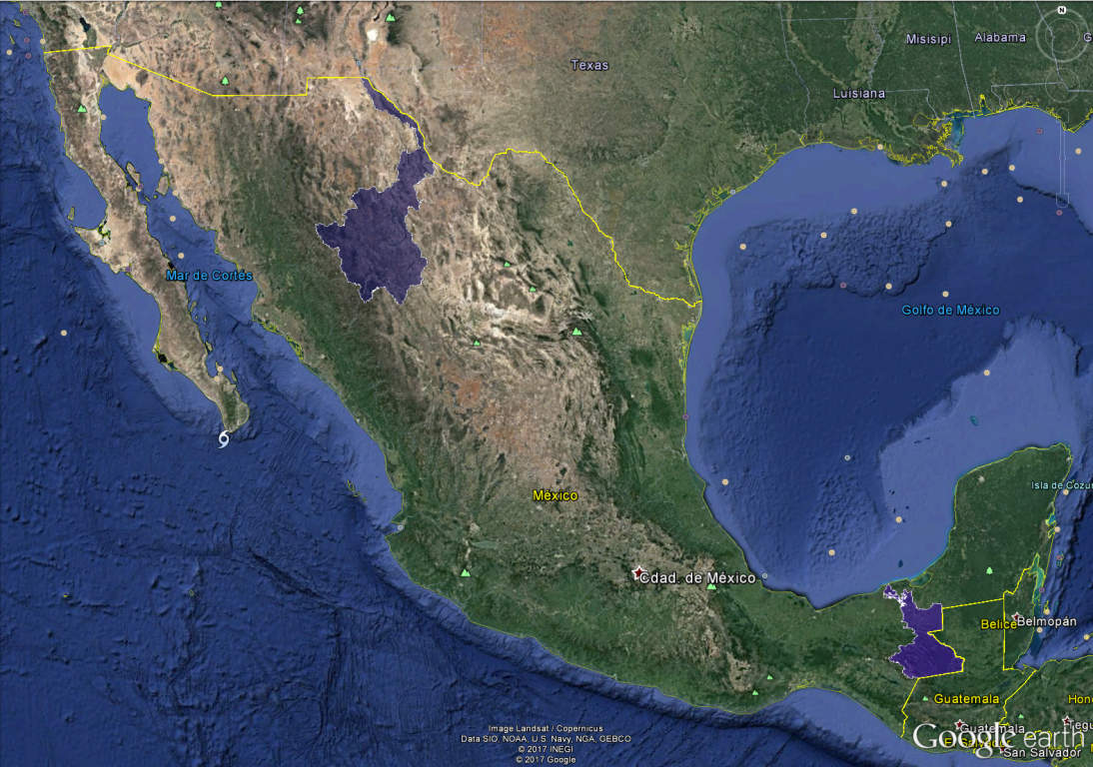
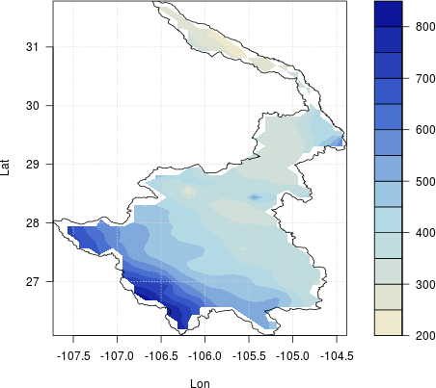
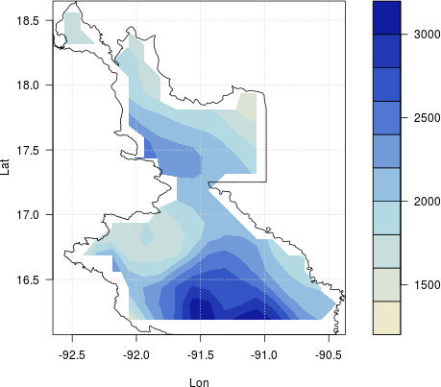
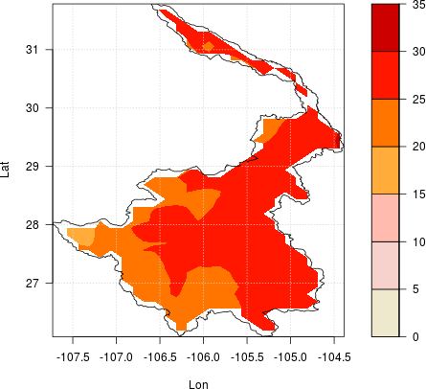
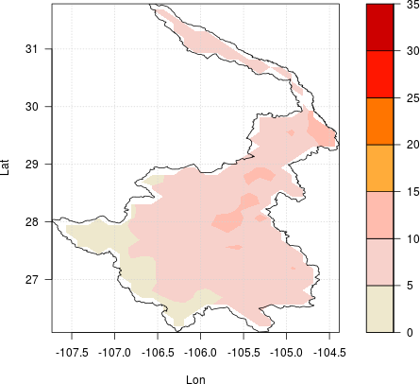
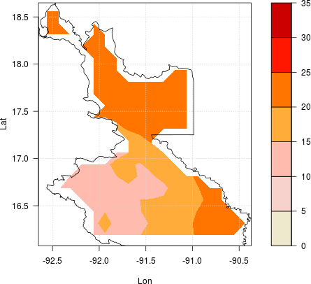
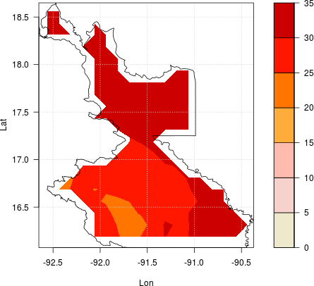
Overview
Conchos
71,964 km²
Mostly Arid
Mountains at SW (<2500m asl)
Lowest at 1000m asl
Usumacinta
30,670 km²
Tropical Humid
Mountains at SW
(< 2000m asl)
Lowest at 0m asl
Conchos
Basin
Annual Precip (mm)
850
Annual Precip (mm)
3200
Usumacinta
Basin
200
1300
1961-1990
1965-1994
Avg Tmax (C)
Avg Tmin (C)
Avg Tmin (C)
Avg Tmax (C)
35
35
0
0

Slide 3
Goal, Data & Software
To get a comparison among the climate indices (as defined by ETCCDI) of these important Mexican basins. In addition, an analysis of the SPI behaviour in the two basins is performed.
Data:
CLICOM (Official climate database of Met Sevice in Mexico)
CLICOMg (grid created by CICESE, 1961-2008, 1/8°) not homogen.
(Zhu & Lettenmier, 2007; Muñoz-Arriola et al., 2009)
Software:
RClimDex (Quality Control & Climate Indices) (Zang, 2004)
RHtest (homogeneization test, SNHT)
Climatol (to homogenize the climate data series)
(Guijarro, 2004; 2013 & 2016)

Slide 4
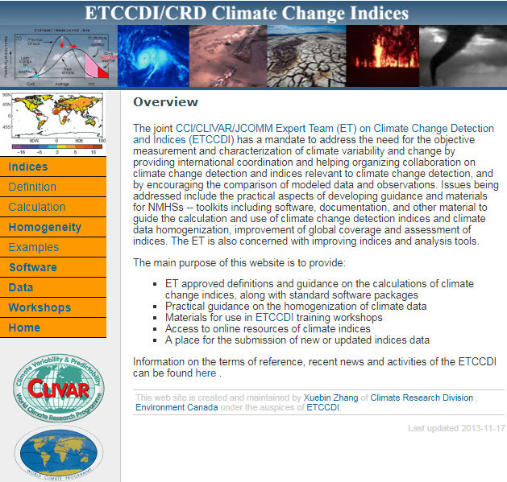
Methodology
CLICOM
Obtaining &
Selecting Data
RClimDex
Data Analysis &
Quality Control
RHtest
Climatol
Homog Test
Homogenized
Data Series
27 ETCCDI Climate Change Indices
Index | Description | Index | Description
FD0 | Number of frost days | WSDI | Warm spell duration index
SU | Number of summer days | CSDI | Cold spell duration index
ID | Number of icing days | DTR | Daily temperature range
TR | Number of tropical nights | Rx1day | Monthly max 1-day precip
GSL | Growing season length | Rx5day | Monthly max consecutive 5-day precip
TXx | Monthly max value of daily max temp | SDII | Simple precip intensity index
TNn | Monthly max value of daily min temp | R10mm | Annual # days when PRCP≥10mm
TXn | Monthly min value of daily max temp | R20mm | Annual # days when PRCP≥20mm
TNn | Monthly min value of daily min temp | Rnnmm | Annual # days when PRCP≥nnmm
TN10p | % of days when TN<10th percentile | CDD | Max length of dry spell
TX10p | % of days when TX<10th percentile | CWD | Max length of wet spell
TN90p | % of days when TN>90th percentile | R95pTOT | Annual total PRCP when RR>95p
TX90p | % of days when TX>90th percentile | R99pTOT | Annual total PRCP when RR>99p
--- | --- | PRCPTOT | Annual total precip in wet days
RClimDex
Climate Indices

Slide 5
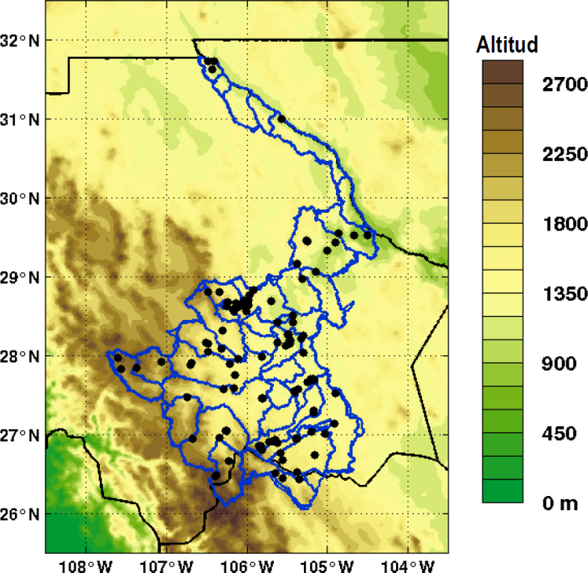
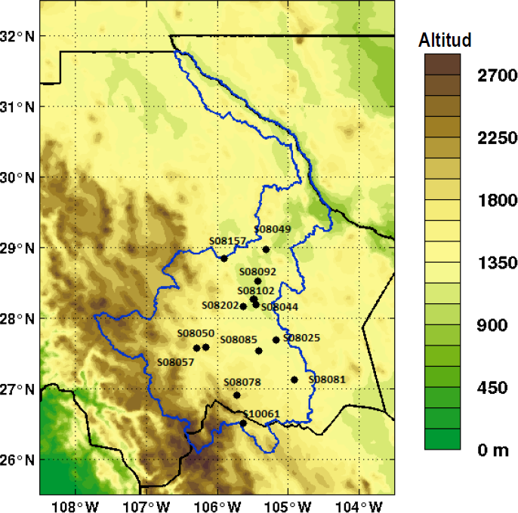
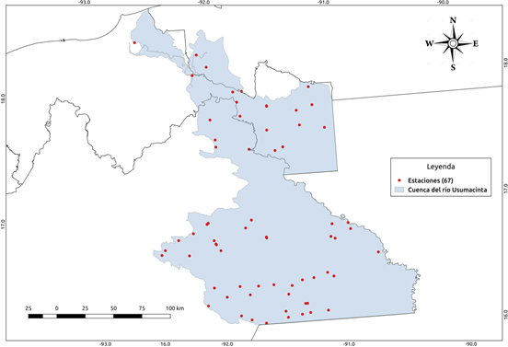
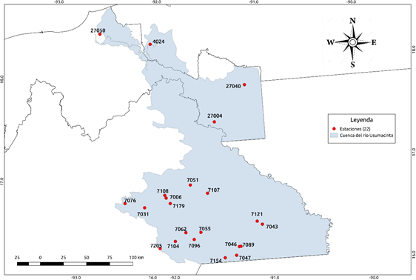
Final Homogenized Stations
1961-1990
Conchos 110 sta
Conchos 14 homog sta
 | Conchos (1961-1990) |  | Usumacinta (1965-1994)
 | Temp | Precip | Temp | Precip
Total Climate Stations | 110 | 110 | 67 | 67
Stations with QC & more than 80% of the data | 14 | 21 | 22 | 31
Final Homogen. Stations | 14 | 14 | 22 | 22
Usumacinta 67 sta
Usumacinta 22 homog sta
1965-1994

Slide 6
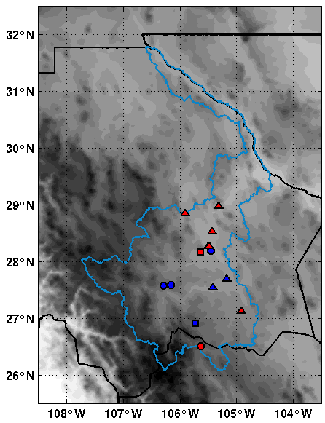
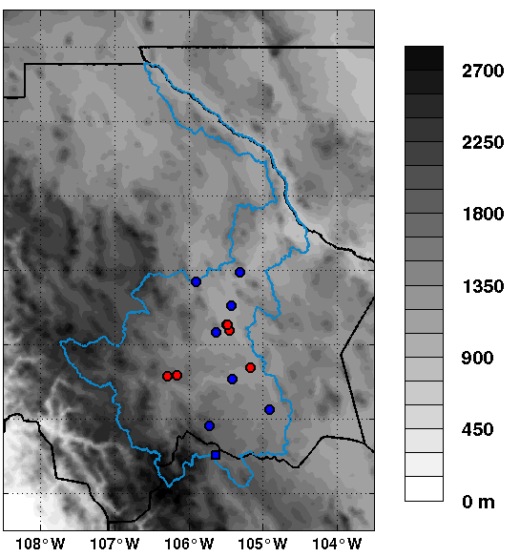
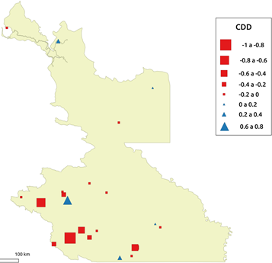
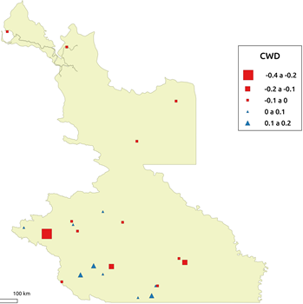
CCI Comparison - Precipitation
CDD
CWD
Max length of dry spell
Max length of wet spell
CDD
CWD

Slide 7
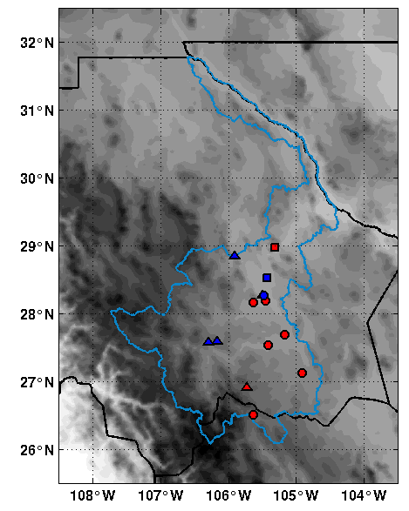
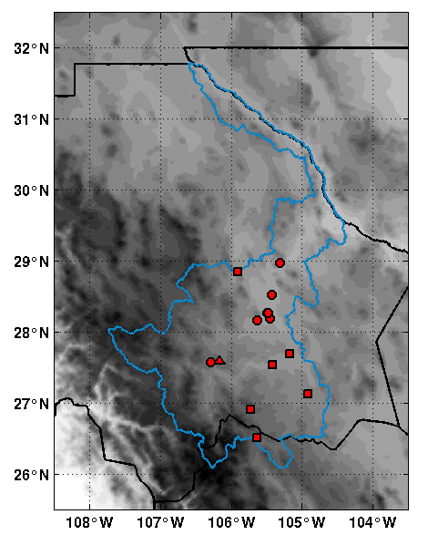
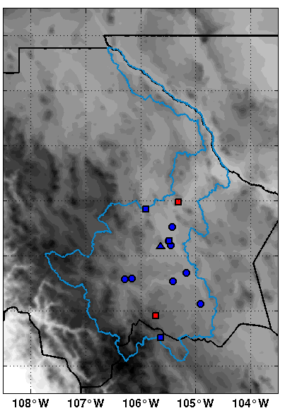
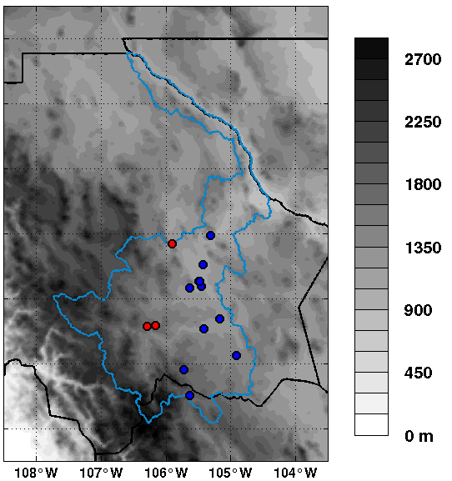
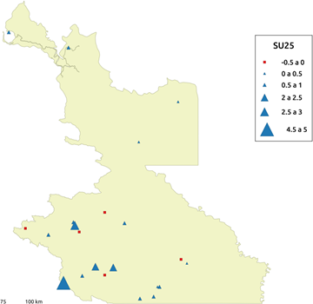
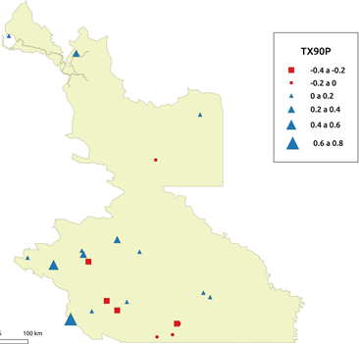
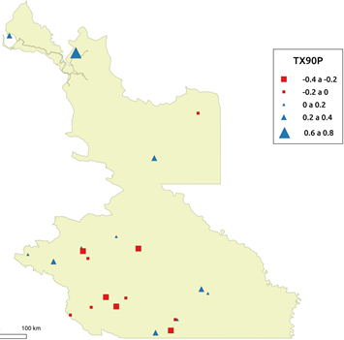
CCI Comparison - Temperature
SU25
FD0
TX90p
TN90p
Frost days
% of days when
TX>90th percentile
% of days when
TN>90th percentile
Summer days
SU25
TX90p
TN90p
TN90P

Slide 8
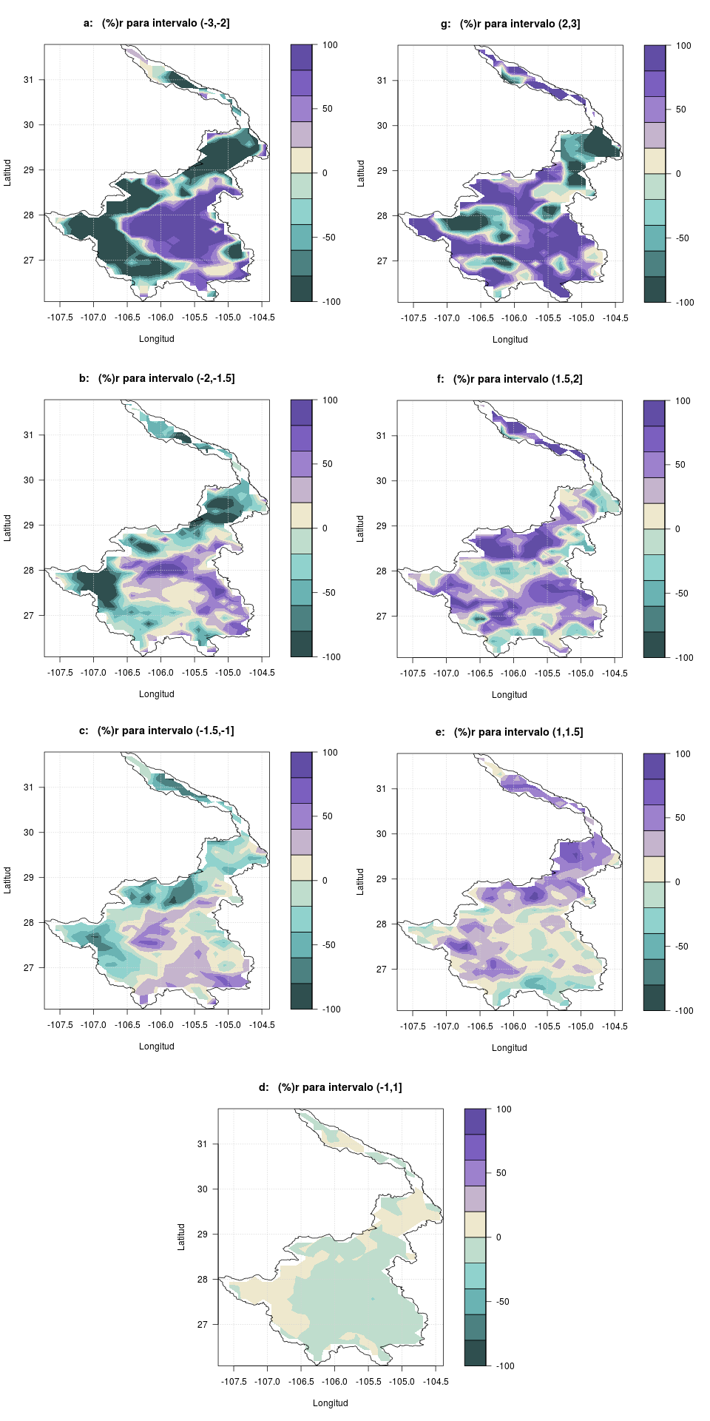
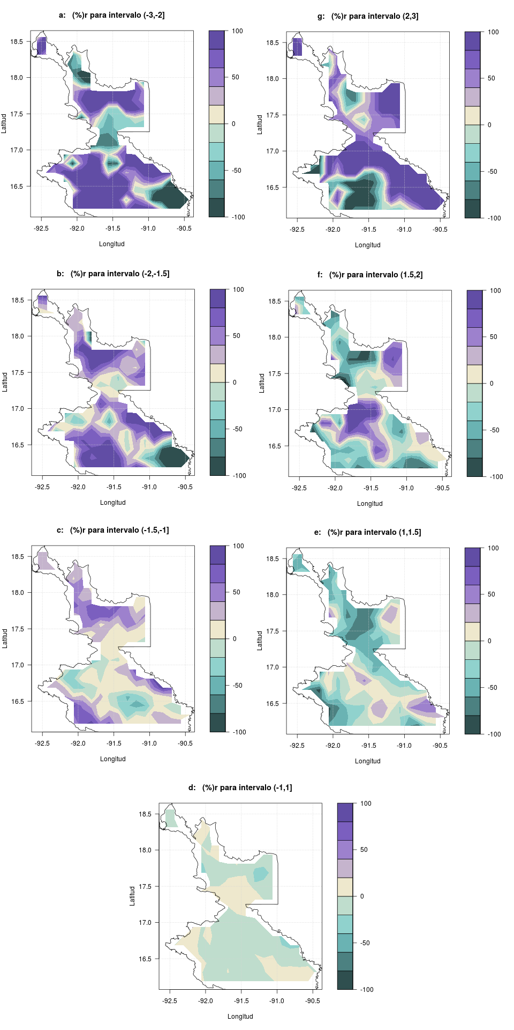
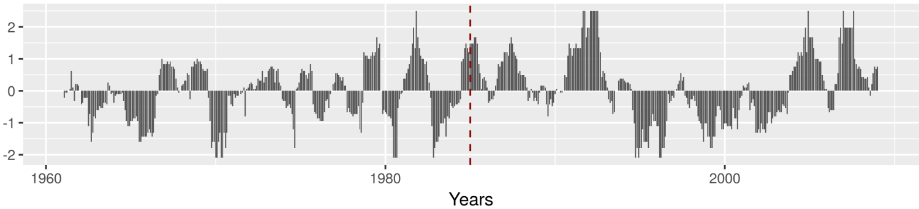
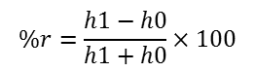
SPI-12 Analysis Comparison
Conchos
Usumacinta
ed
ew
ed
ew
SPI | Category | Probability
≥ 2.0 | extremely wet (ew) | 0.023
1.5 to 1.99 | severely wet (sw) | 0.044
1.0 to 1.49 | moderately wet (mw) | 0.092
-0.99 to 0.99 | approx normal (an) | 0.682
-1.0 to -1.49 | moderately dry (md) | 0.092
-1.5 to -1.99 | severely dry (sd) | 0.044
≤ -2 | extremely dry (ed) | 0.023
sd
100
sw
sd
100
sw
0
0
-100
-100
$$\%r=\frac{h1−h0}{h1+h0}×100$$
md
mw
md
mw
%r > 0 (purple) → recent period dominates
(1985-2008)
%r < 0 (emerald) → old period dominates
(1961-1984)
old
recent
Conchos basin
Avg SPI-12
1961-2008
1985

Slide 9
Summary & Conclusions
Unfortunately, Mexico has not done a good job on maintaining and calibrating its climate stations in the last few decades and it is now very difficult to assess any climate change in recent years.
Just about 13% of total Conchos’ stations and about 33% of Usumacinta ones were useful for homogeneization and in a relatively short and not so recent period. Homogenized stations are not uniformly distributed for both basins.
For the studied periods, negative trends prevailed for most of the CCI-Precip, especially for Usumacinta. SU25 positive trends dominated for most of the Usumacinta. FD0 decreased for the whole Conchos basin.
SPI-12 analysis showed that dry and wet periods are probably getting longer and stronger in the recent decades for the Conchos. On the other hand, it was shown that extreme dry and wet periods are getting more frequent in the last decades for most of Usumacinta.

Slide 10
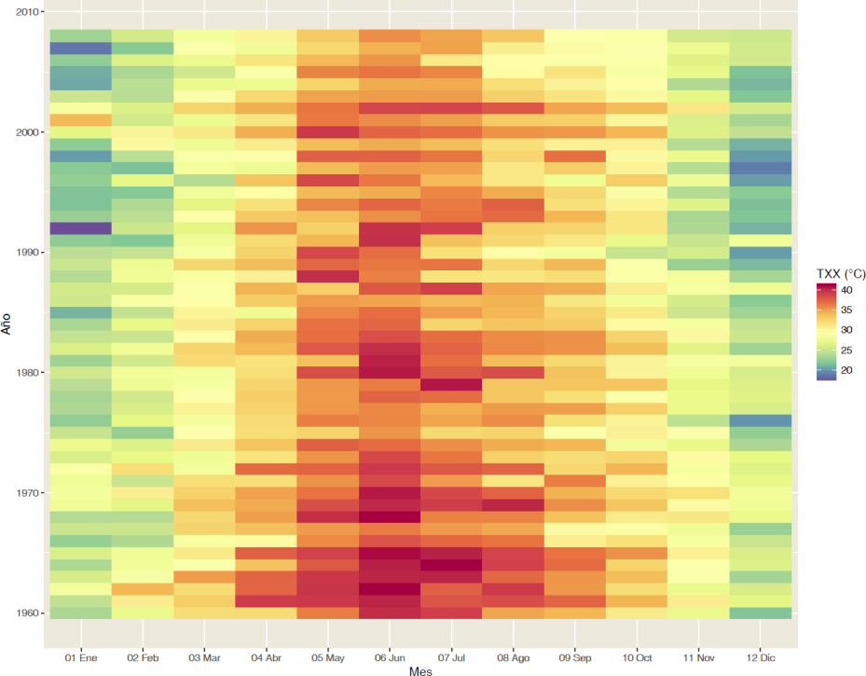
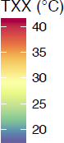
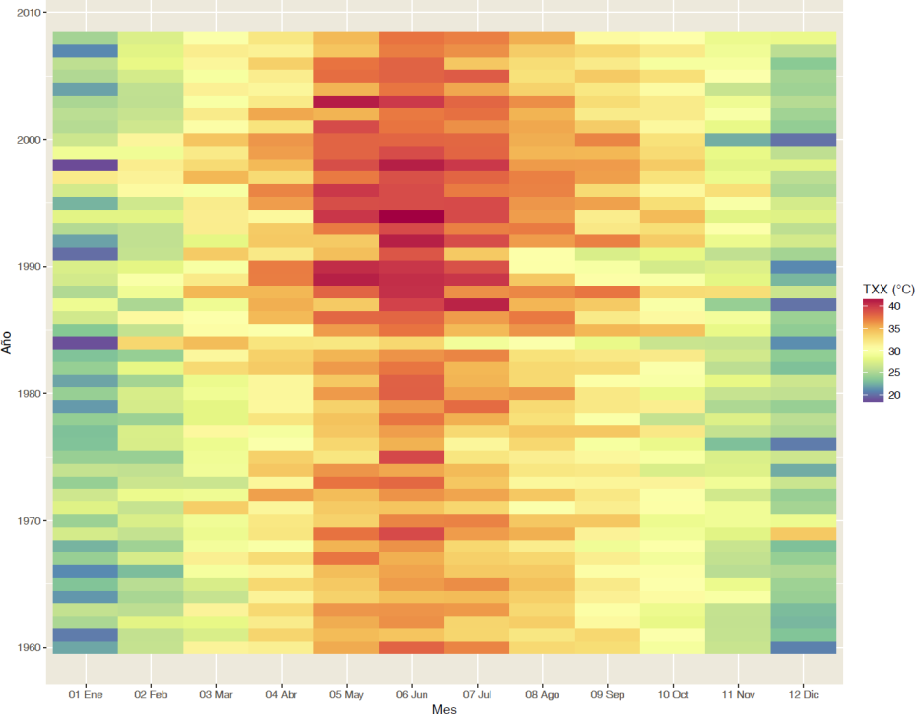
2010
TXX (C)
Monthly max value of daily Tmax
s08157
1960
Jan
Jun-Jul
Dec
2010
s08092
1960

